Slide 1
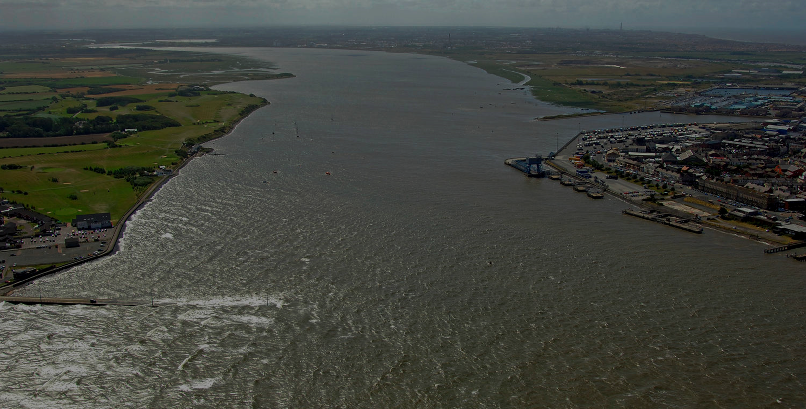
THE MOST SIGNIFICANT UK INFRASTRUCTURE PROJECTS SINCE THE MOTORWAYS
WWW.TEDD.GROUP
Natural Energy Wyre Ltd trading as TEDD Group

Slide 2
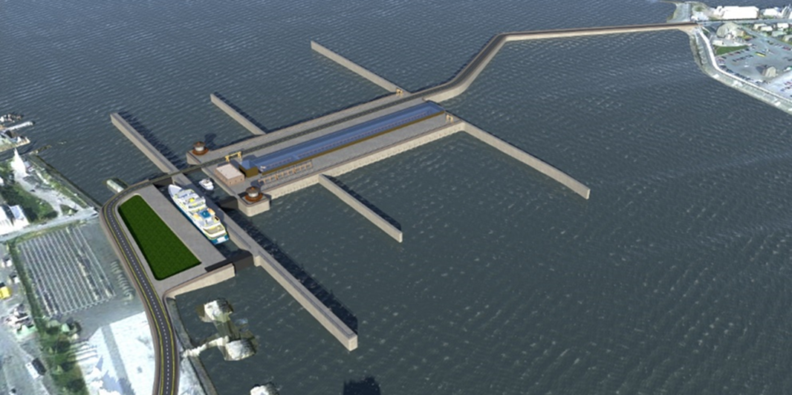
THE RIVER WYRE
Small fishing vessel & non-commercial lock/dock. Free of charge
Irish Sea
Safe mooring haven
Turbines
Heavy commercial lock/dock
To the Port of Fleetwood

Slide 3
NOW FUNDING THE PILOT PROJECT
Tidal Energy & Defence Developments (TEDD) is now SEED funding in preparation for one of the largest Crowdfunding Campaigns ever experienced in the UK.
The Campaign will allow TEDD Group to finance Pre-Construction Development of the Wyre Project.
Backed by 350 PPM Ltd, the environmental incubator responsible for organising funding.
TEDD is seeking unwavering, NON-FINANCIAL support from the Government, so it can fund its development, generate cheap electricity and protect homes and businesses from flooding.

Slide 4
Advisors

Slide 5
Tidal power helps solve problems
Climate Crisis: Global Warming Not Stopping
Energy Crisis: Electricity Prices
Tidal Flooding: Sea Level Rise – The Rate of Increase is Increasing

Slide 6
The Pilot Project
The Natural Energy Wyre Tidal Energy & Defence Project:
Provides enough electricity for 30,000 houses
Brings employment and rehabilitation to the local area
Reduces UK emissions and lower electricity prices
Protects local residents and businesses from the increasing risk of tidal surges
Grows confidence for other self-funded larger tidal projects
The TEDD team has direct experience of over 30 successful Hydroelectric Projects, including the 1500 MW Coca Coda Sinclair Project in Ecuador, which now provides 1/3 of Ecuador’s power.

Slide 7
The pilot project (continued)
Natural Energy Wyre Ltd, part of TEDD Group, is the most advanced project in the UK today.
Quantified, developed and audited for financial success, without subsidy.
Dynamic fundraisers, 350 PPM Ltd, pledge to take this company through investment to delivery with NO GOVERNMENT FINANCIAL CONTRIBUTION.
An online poll from residents of this once dynamic fishing town shows over 93% support.
We only ask for the Government’s full commitment - doing whatever it takes to assist in the planning process, assuring seamless development.

Slide 8
Site Locations
River Solway
Cumbria/Dumfries & Galloway
Build Cost: £0.8bn
Installed Capacty: 0.3 GW Annual Generation: 0.6 TWh
Start Year: 2025
River Duddon
Cumbria
Build Cost: £10bn
Installed Capacty: 3.8 GW Annual Generation: 7 TWh
Start Year: 2029
River Wyre
Lancashire
Build Cost: £0.3bn
Installed Capacty: 0.1 GW Annual Generation: 0.2 TWh
Start Year: 2023
River Mersey
Merseyside
Build Cost: £3bn
Installed Capacty: 1.2 GW Annual Generation: 2 TWh
Start Year: 2028
River Severn
South Wales/Bristol
Build Cost: £25bn
Installed Capacty: 12 GW Annual Generation: 20 TWh
Start Year: 2031

Slide 9
Just say “Yes” and we’ll do the rest
Questions Please!

Slide 10
THE MOST SIGNIFICANT UK INFRASTRUCTURE PROJECTS SINCE THE MOTORWAYS
WWW.TEDD.GROUP
For further information please contact:
Bob Long
bobl@tedd.group
Nick Dimmock
nickd@tedd.group
Natural Energy Wyre Ltd trading as TEDD Group

